Slide 1

Candidate Insight Project
INF-558 Project Presentation
Anand Prashar
Shiv Prathik Velagala

Slide 2
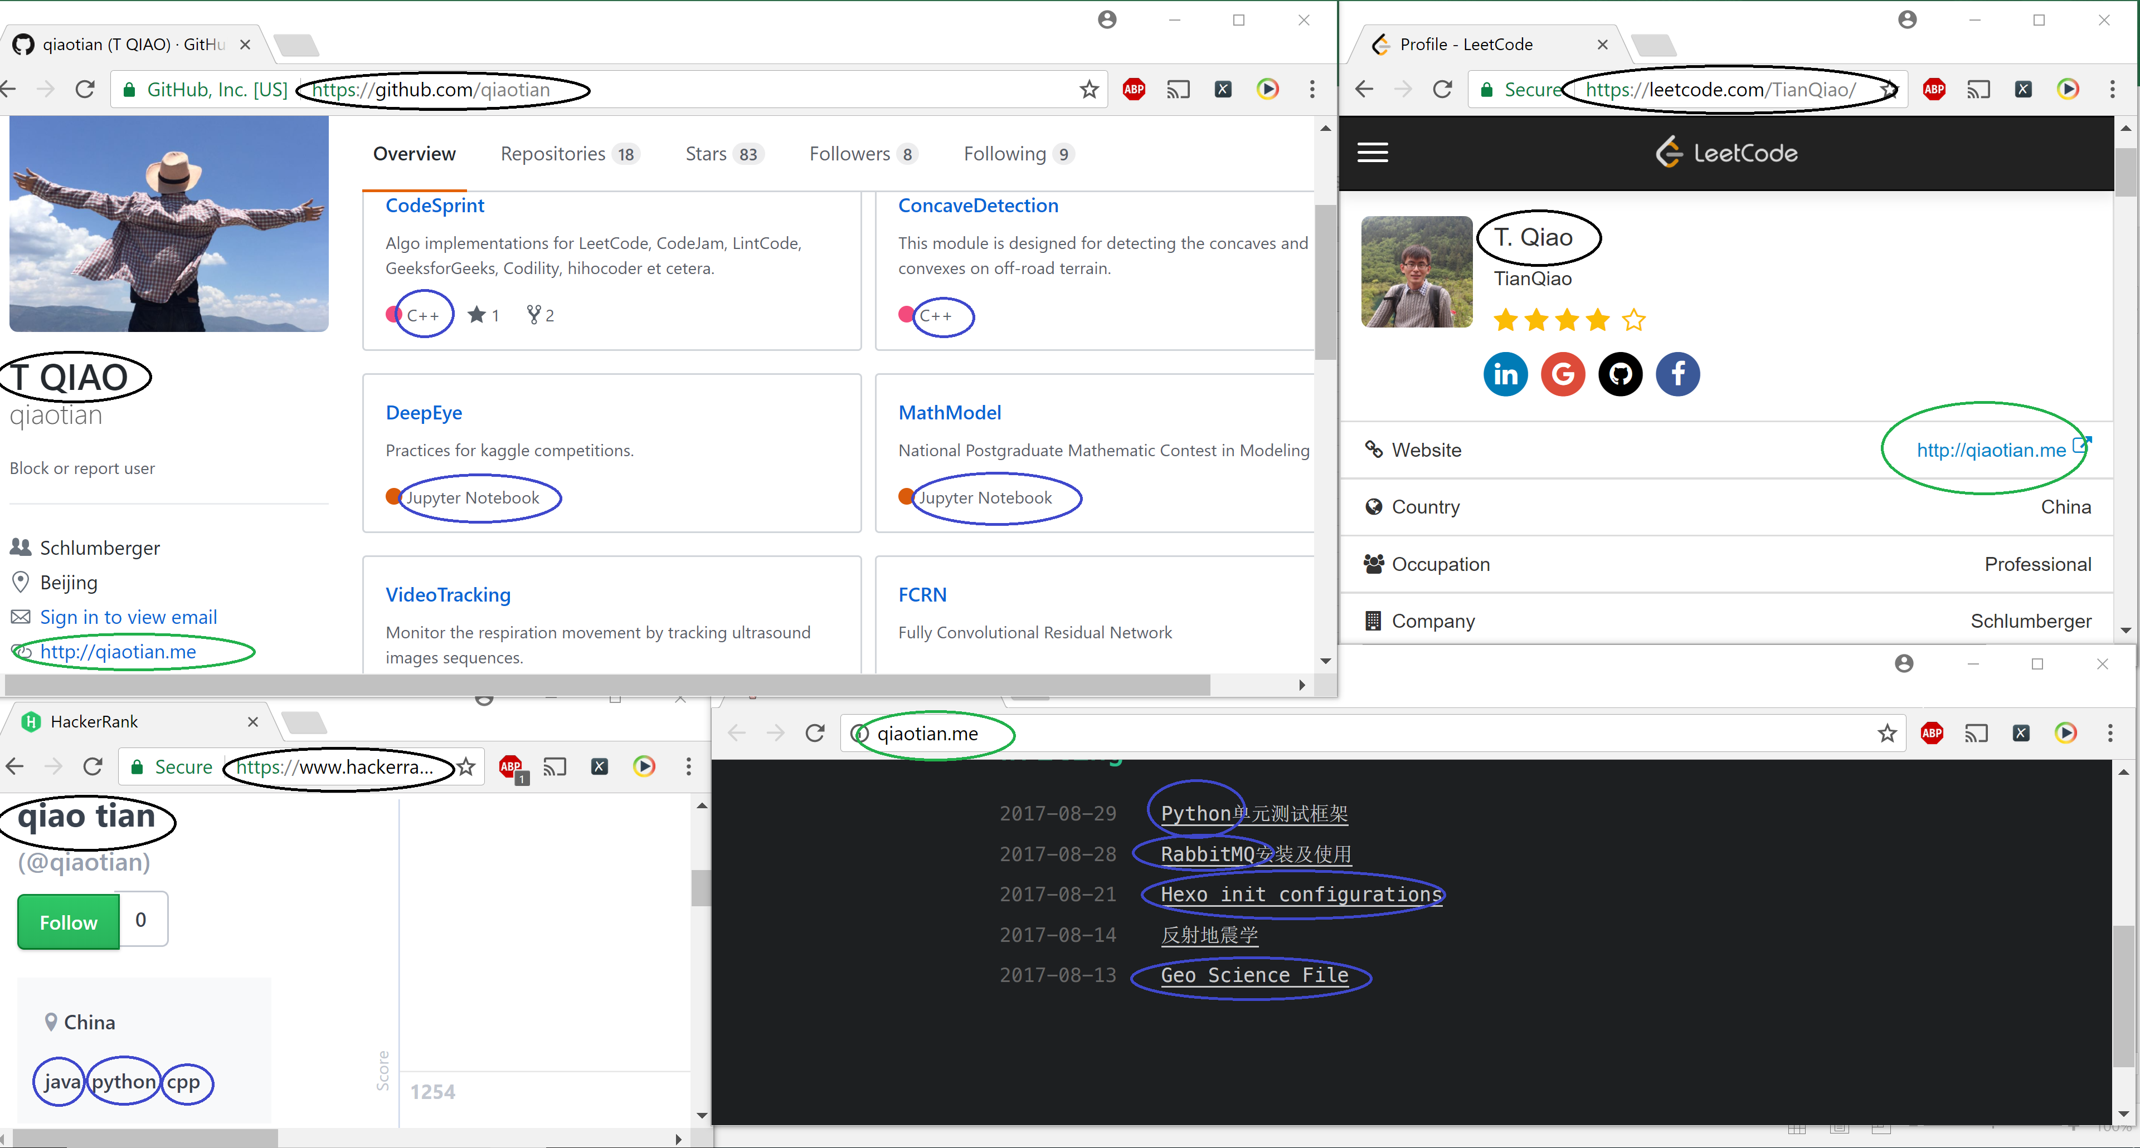
Why this topic?(Holistic view)

Slide 3
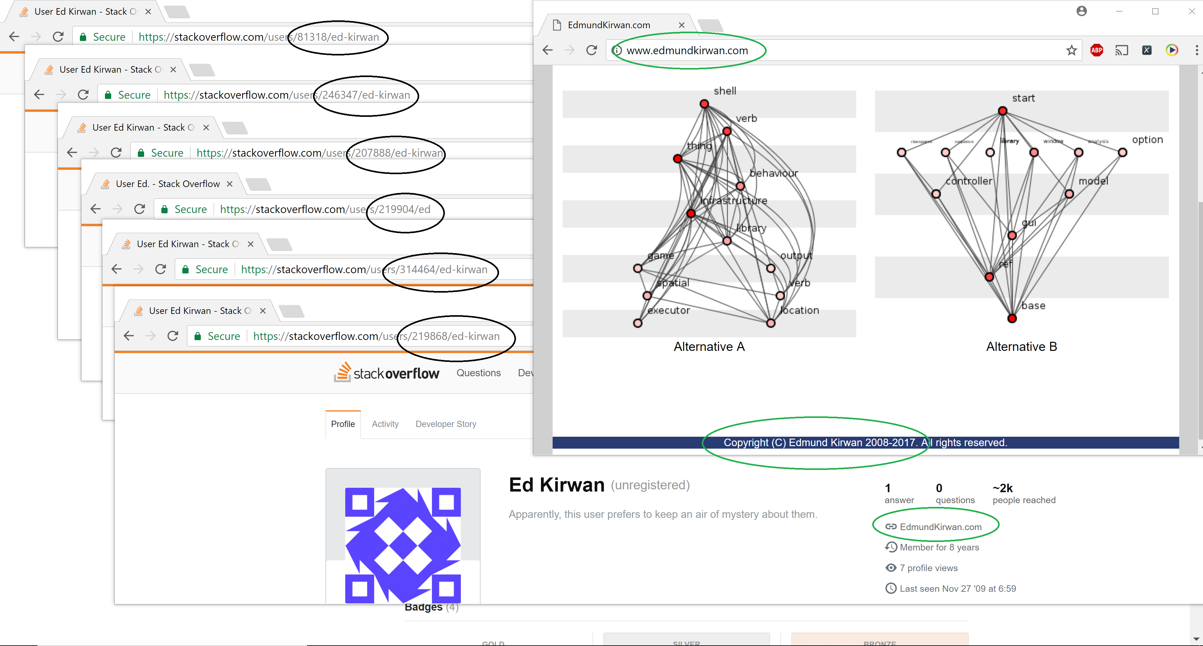
Why this topic?(Duplicate profiles)

Slide 4
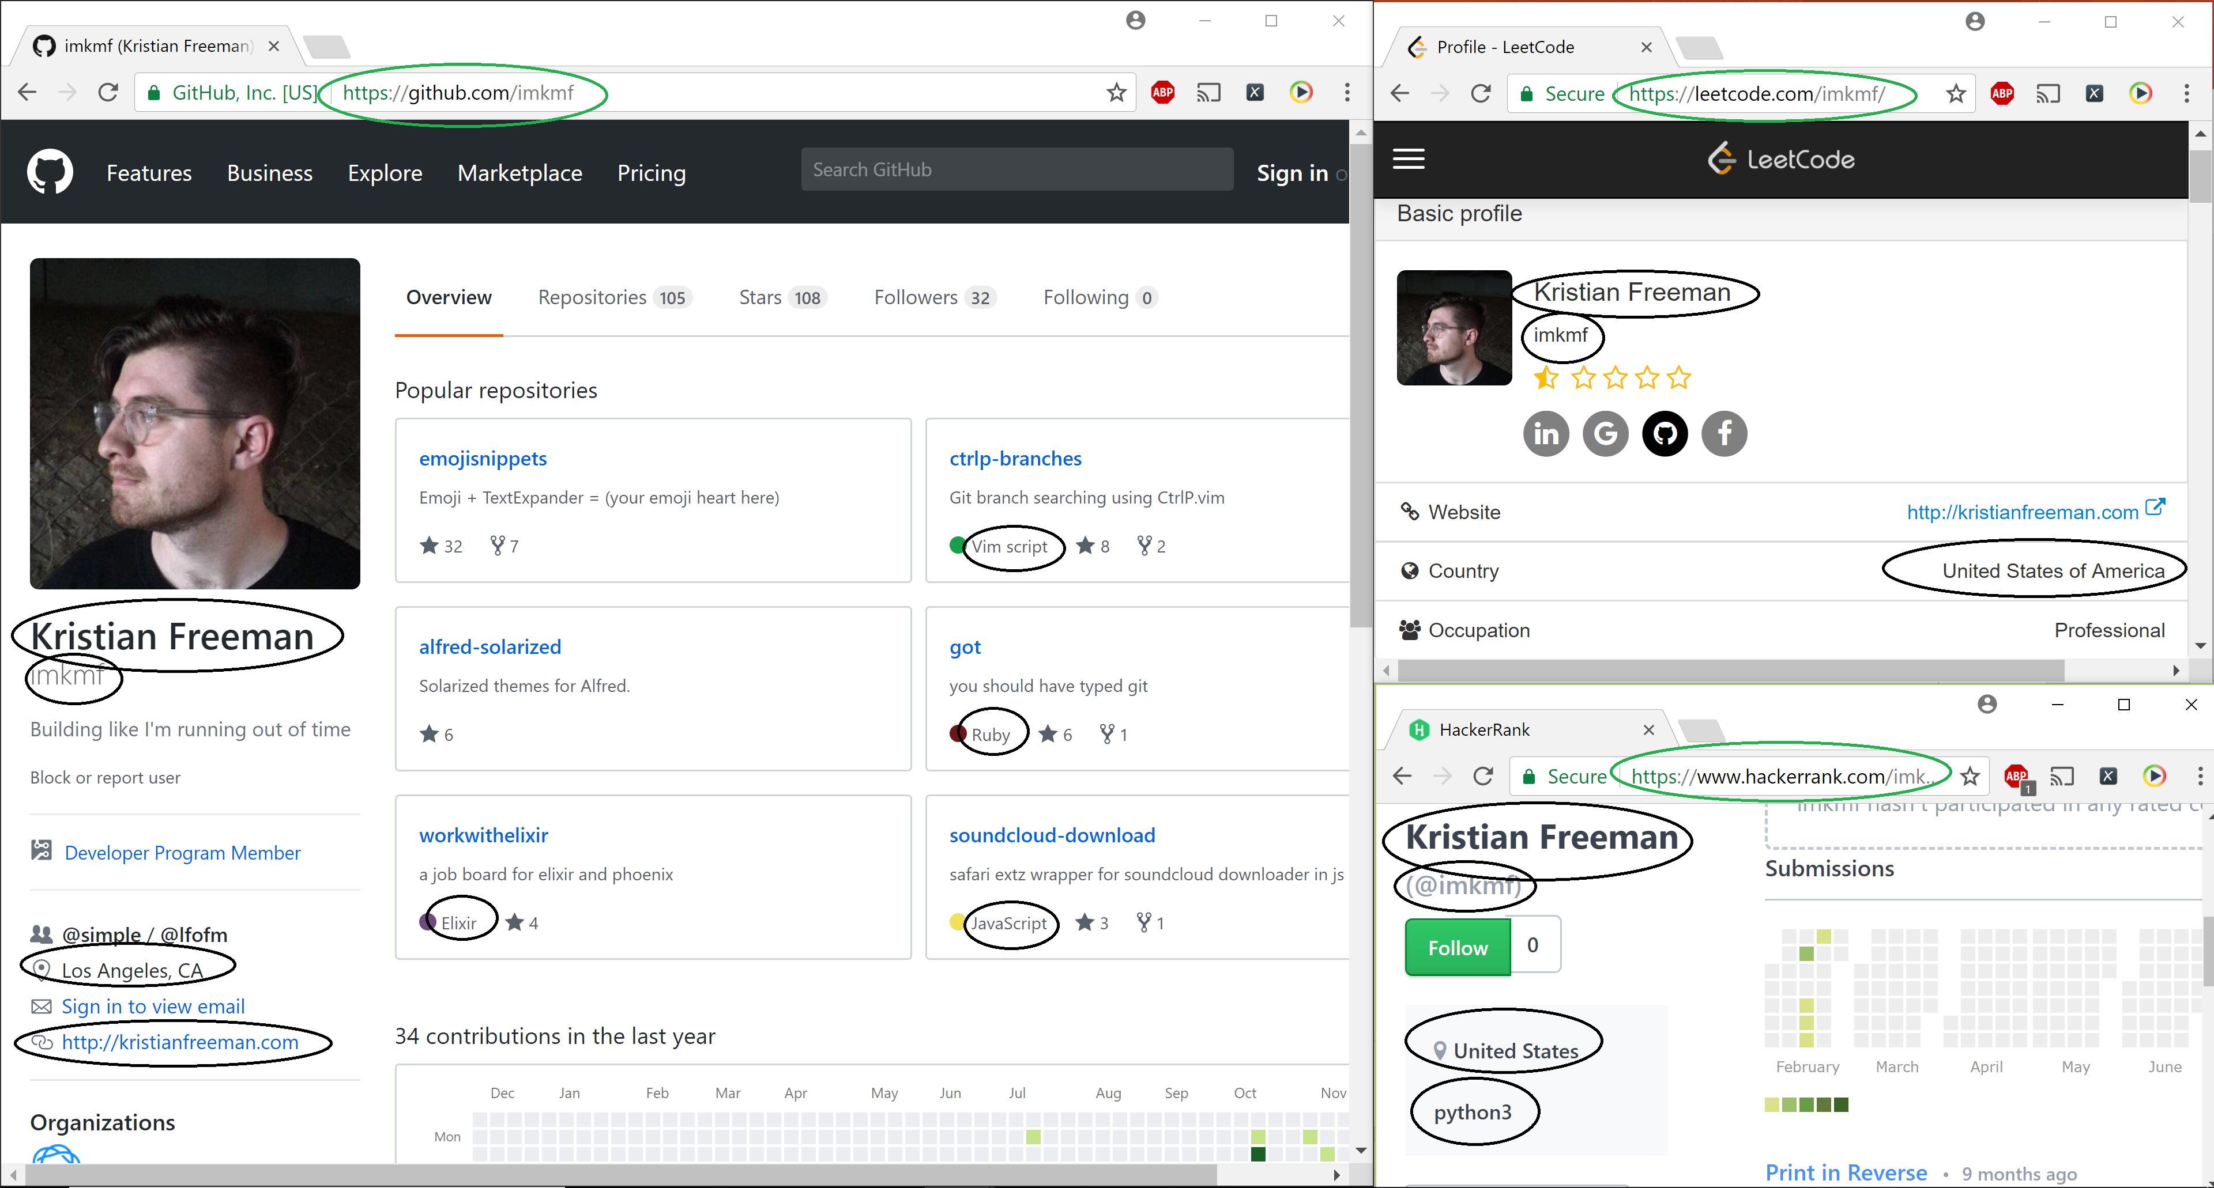
Data Sources
Leetcode
Github
HackerRank

Slide 5
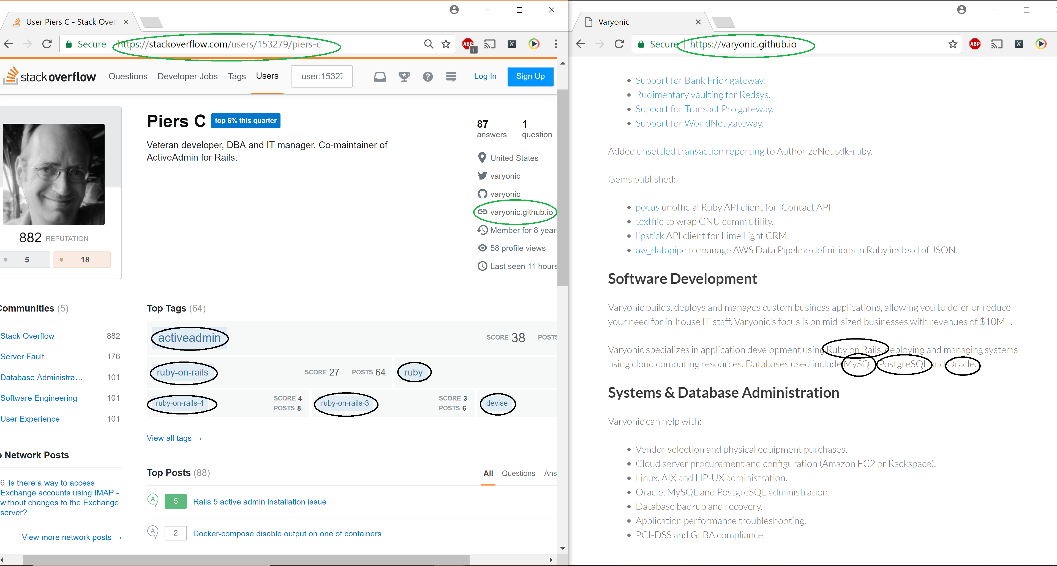
Data Sources
Stackoverflow
Personal Blog

Slide 6
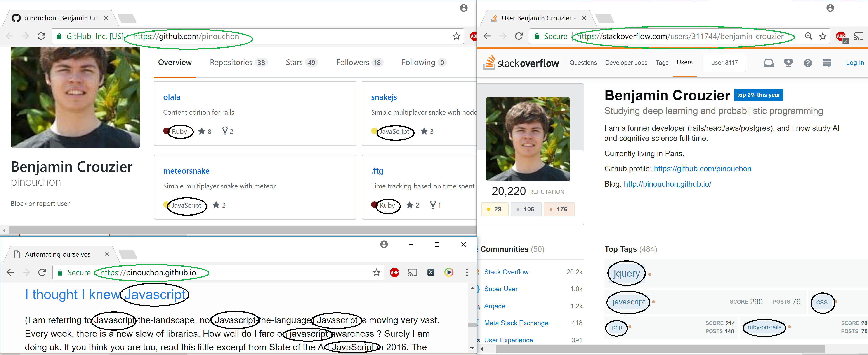
Challenges
Incoherent structure of sources
Nested
Structured
Unstructured

Slide 7
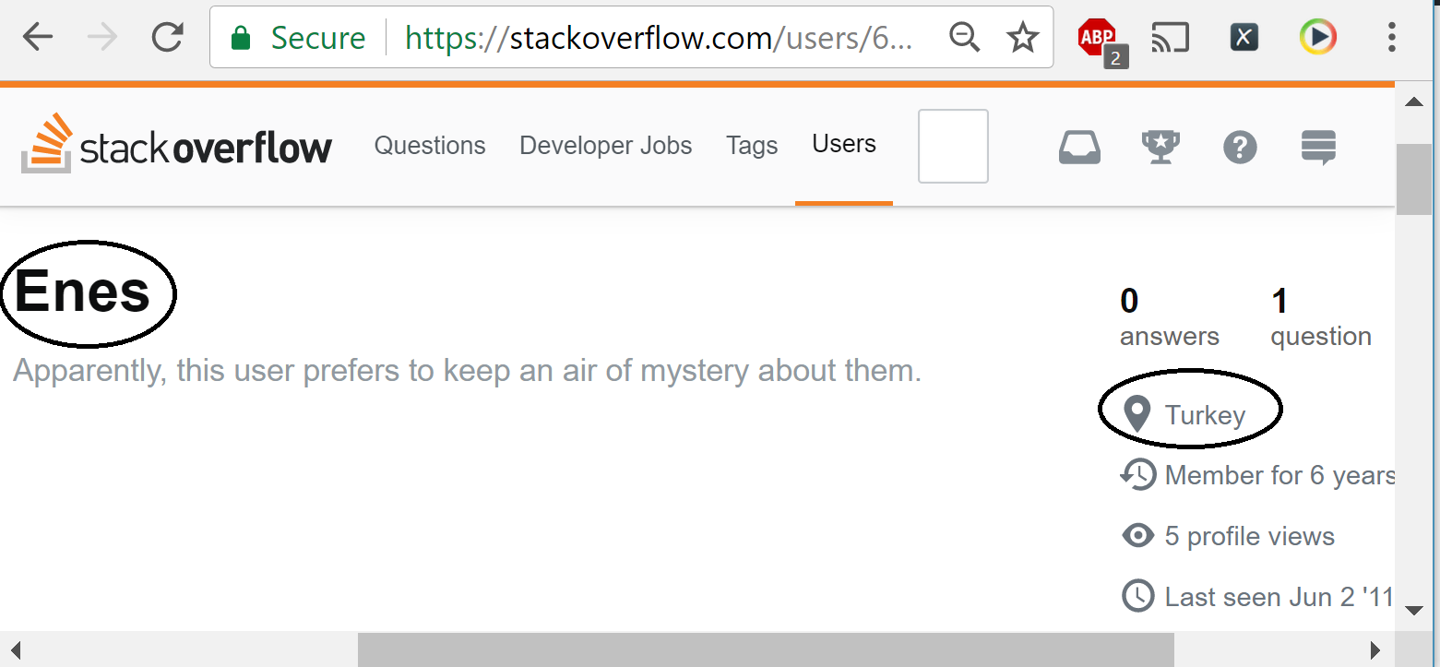
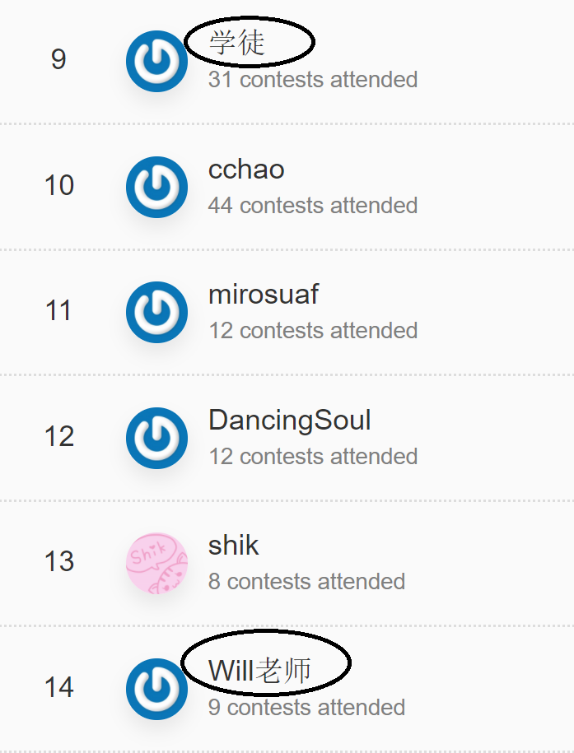
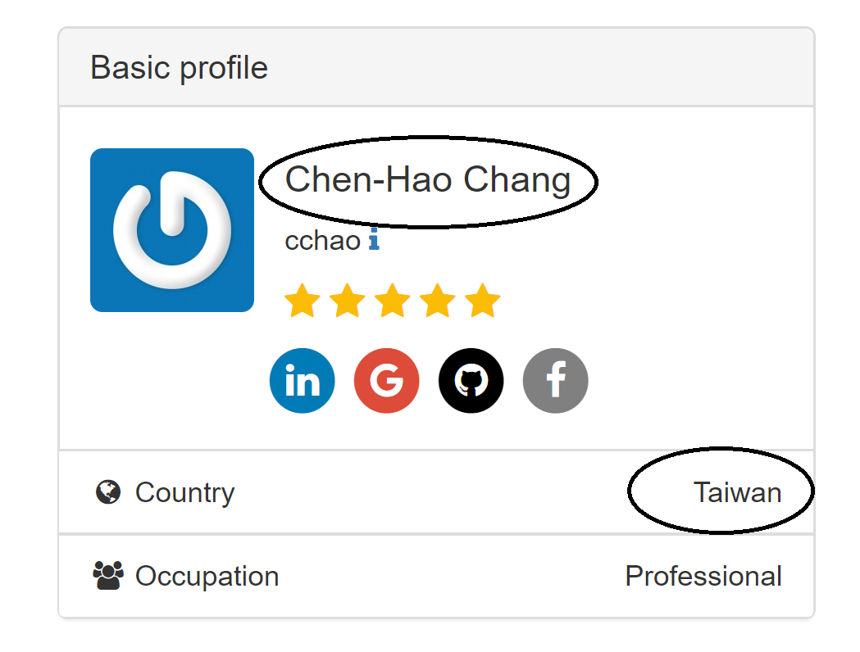
Challenges
Location information not specified explicitly
Messy data

Slide 8
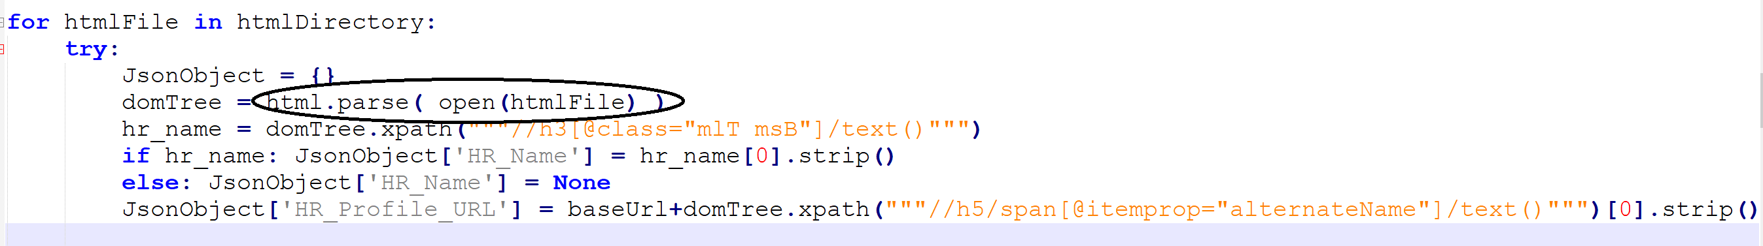
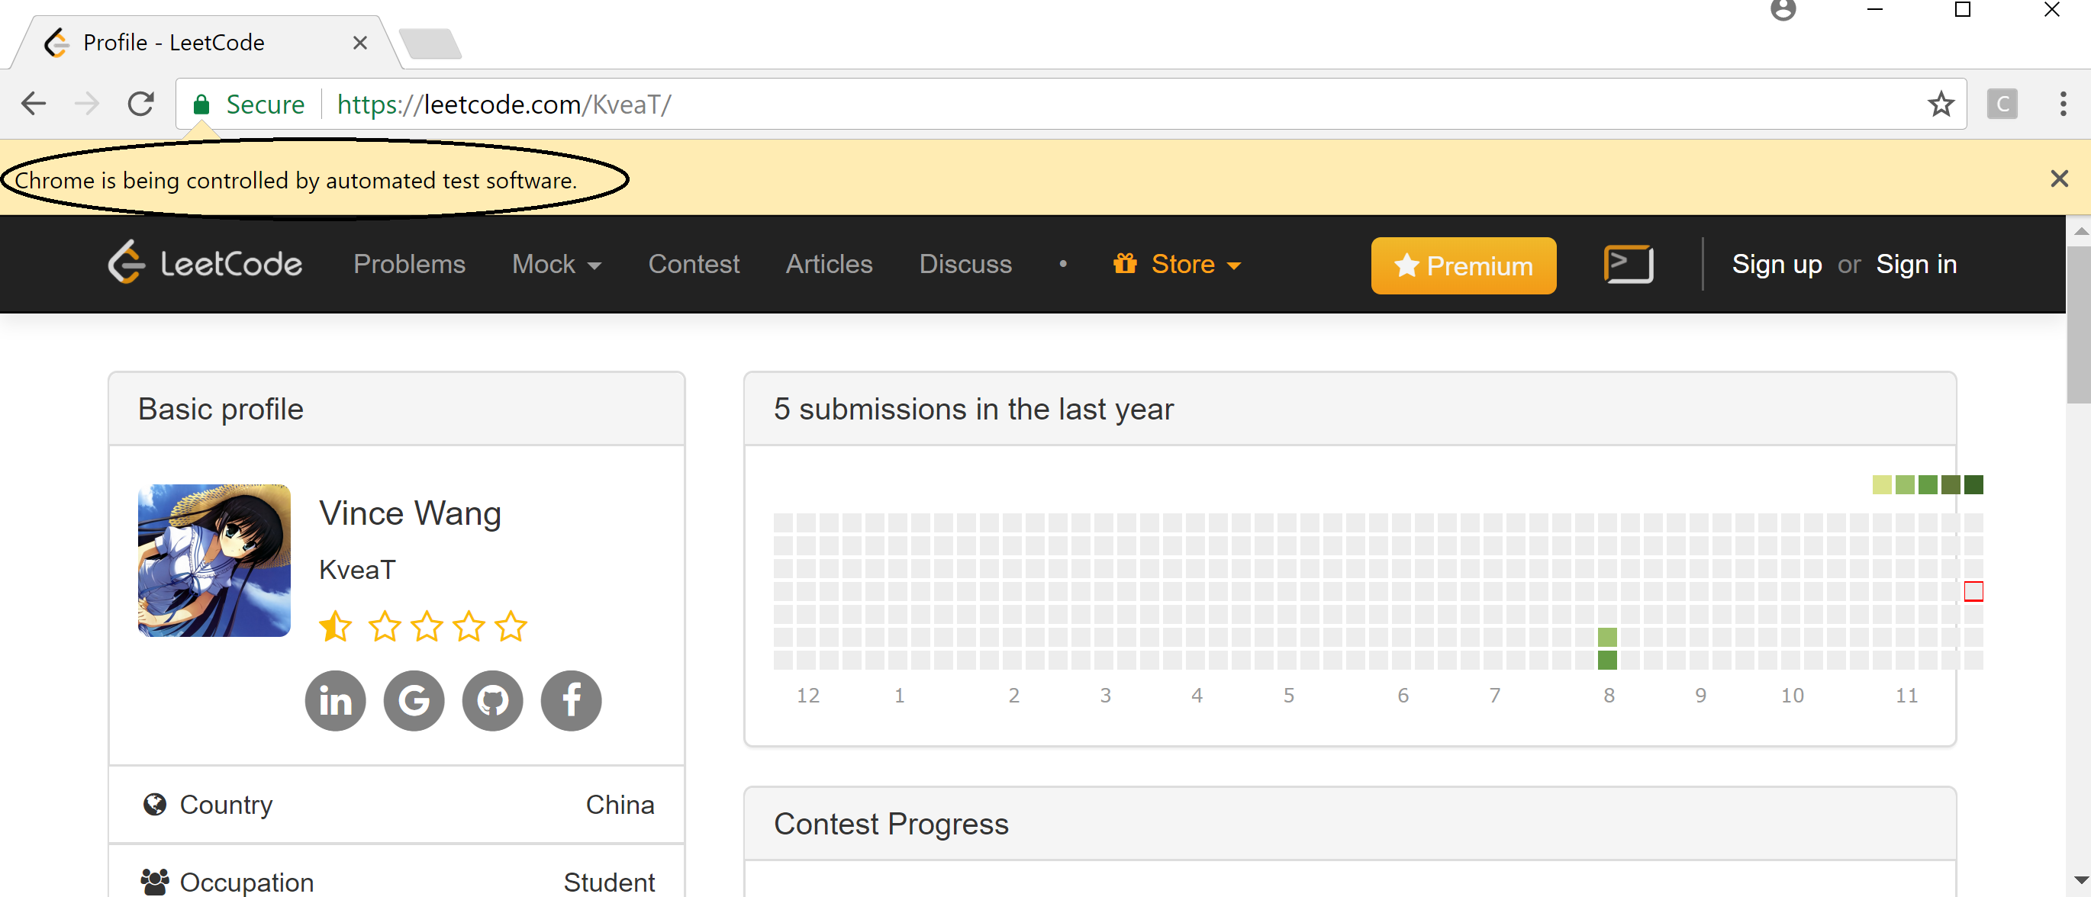
Scraping the data
Scrapy
Selenium

Slide 9
Record Linkage
Matching on the same reference URL
Matching on name
Matching on id
Matching on location

Slide 10
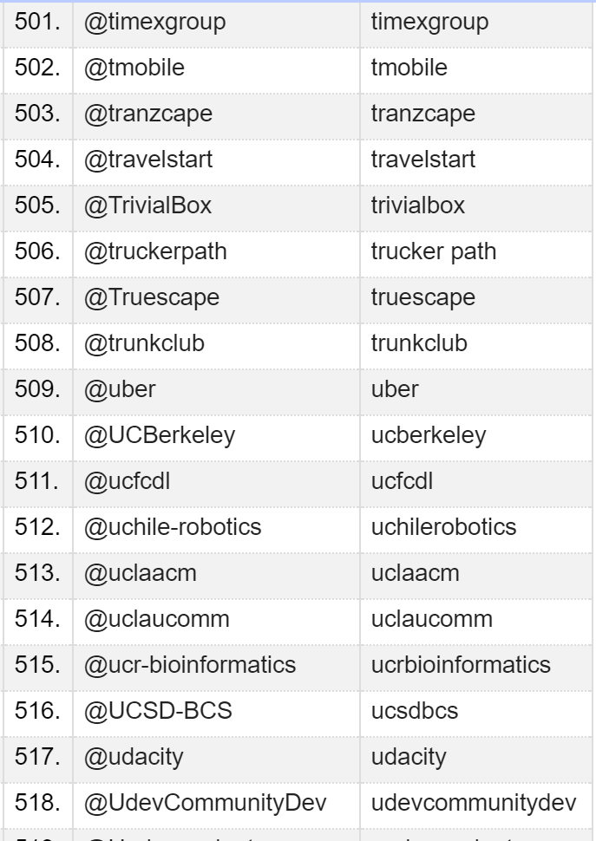
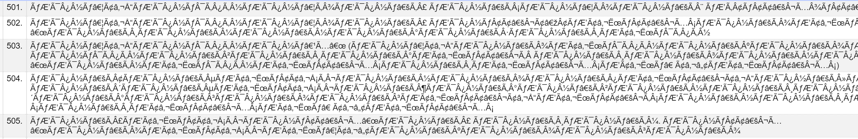
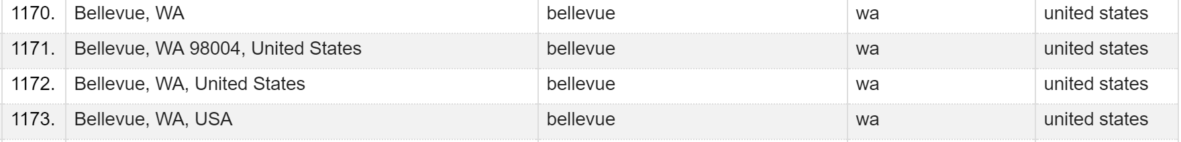
Cleaning the data
The scraped data was cleaned using Google Refine.
Removal of special characters
Dealing with characters in foreign languages
Changing different types of location formats entered by users into a homogeneous format

Slide 11
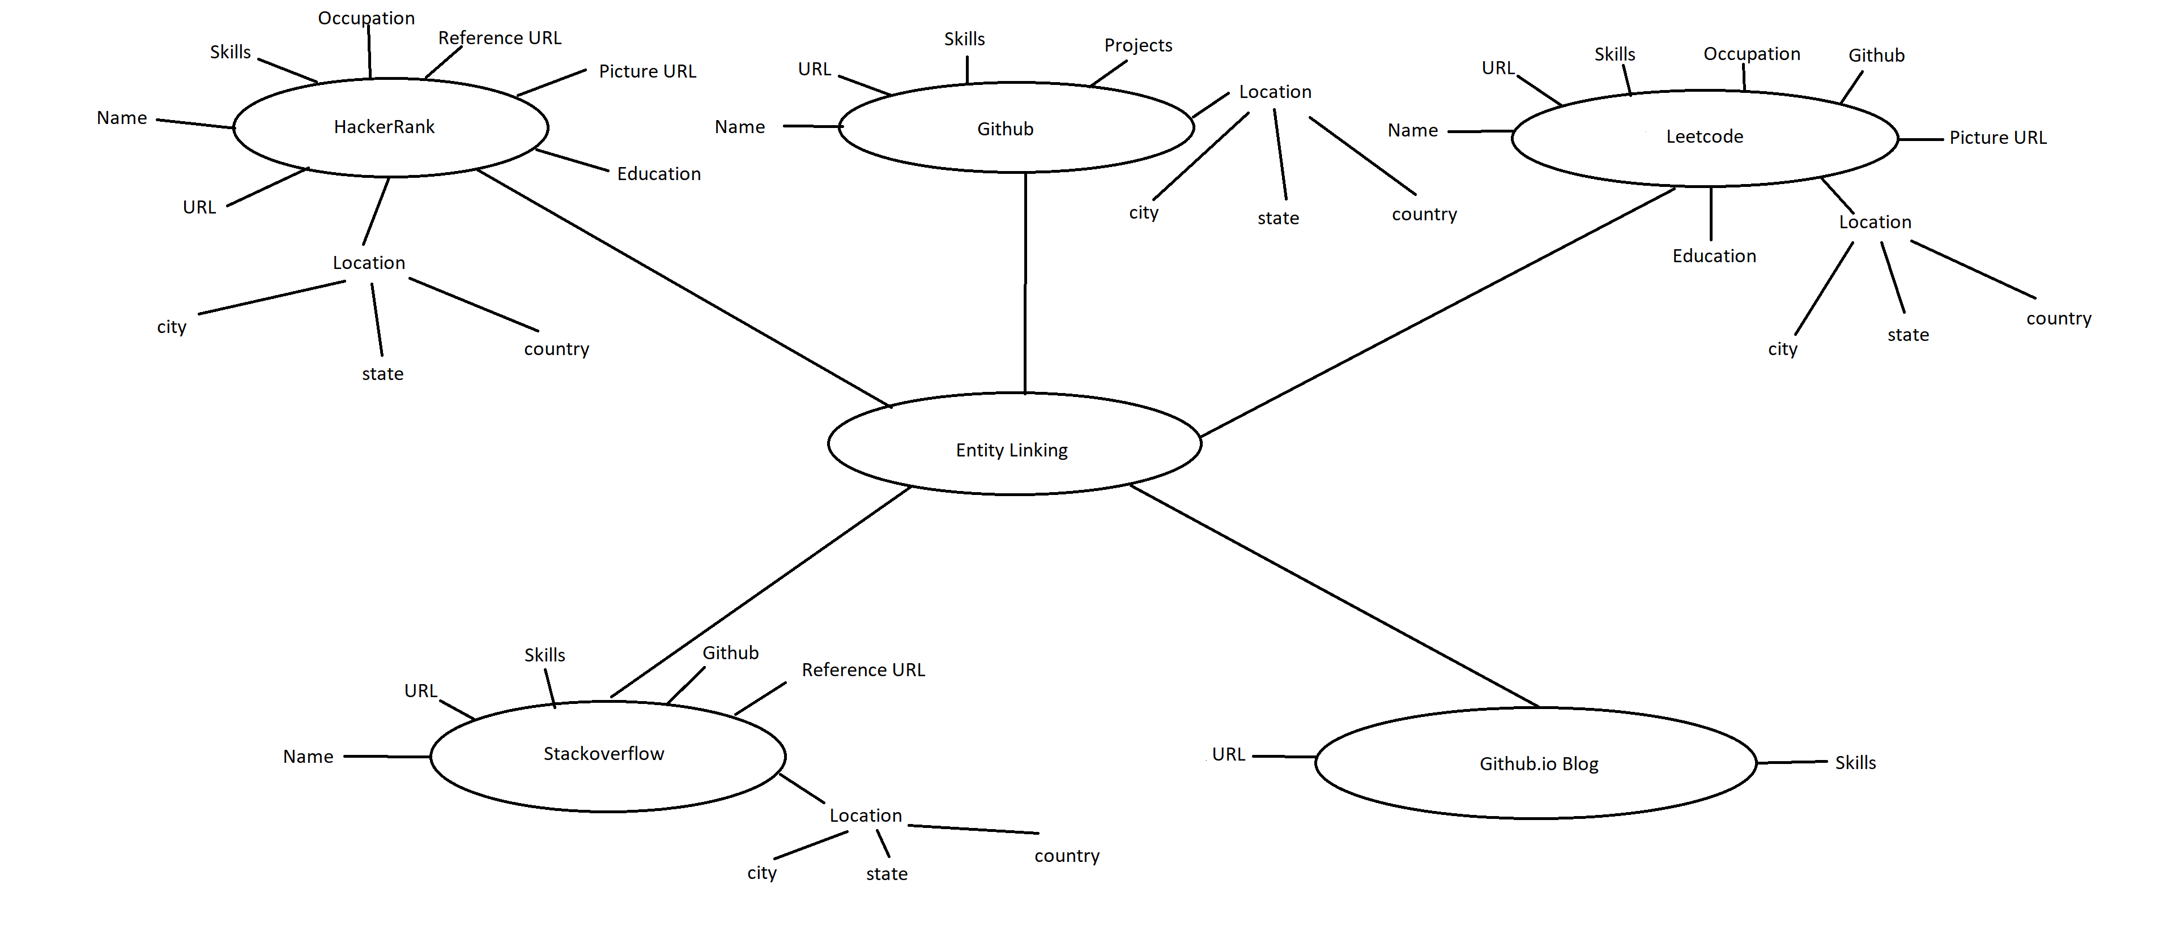
Data model

Slide 12
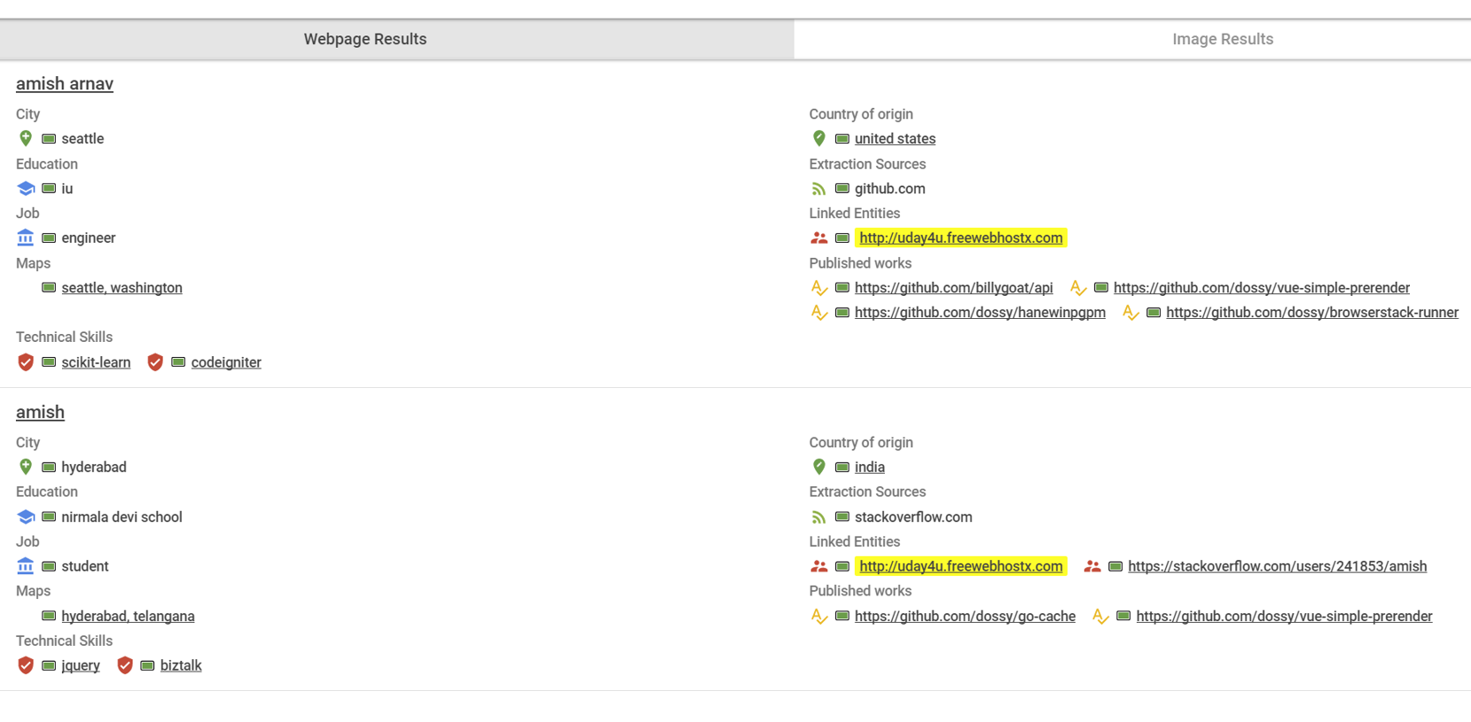
What we achieved!

Slide 13
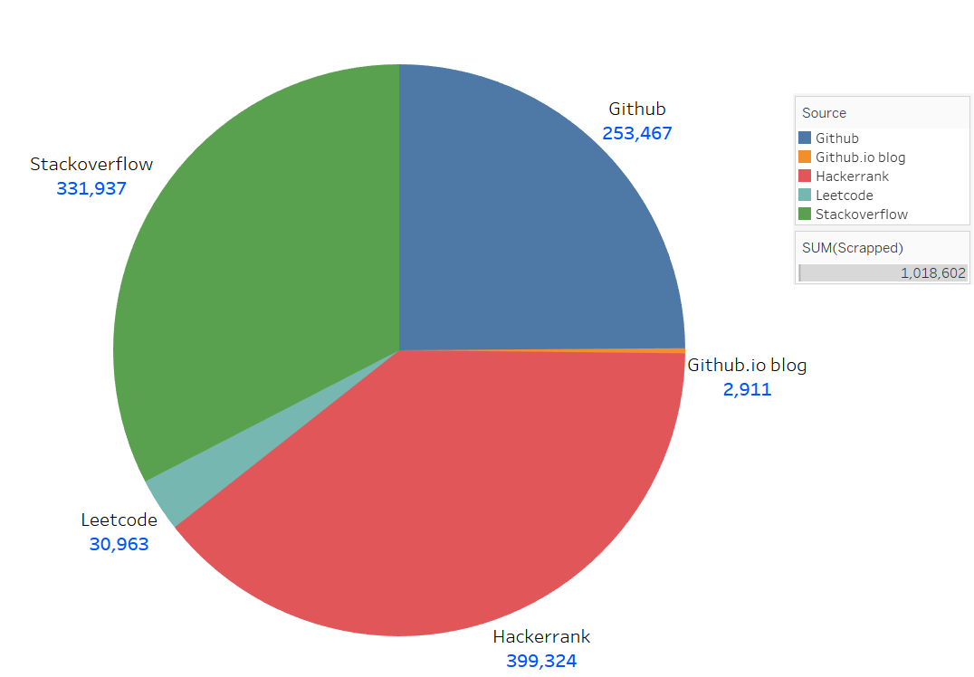
Extraction

Slide 14
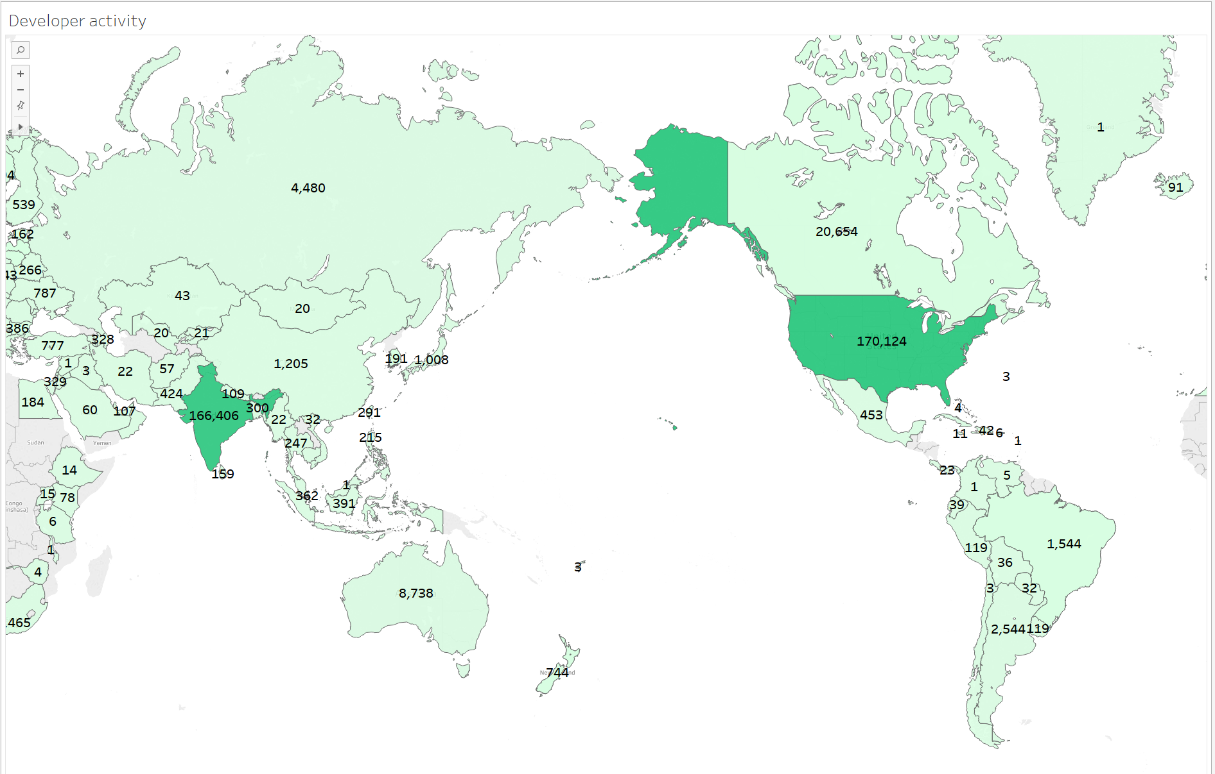
Interesting stuff

Slide 15
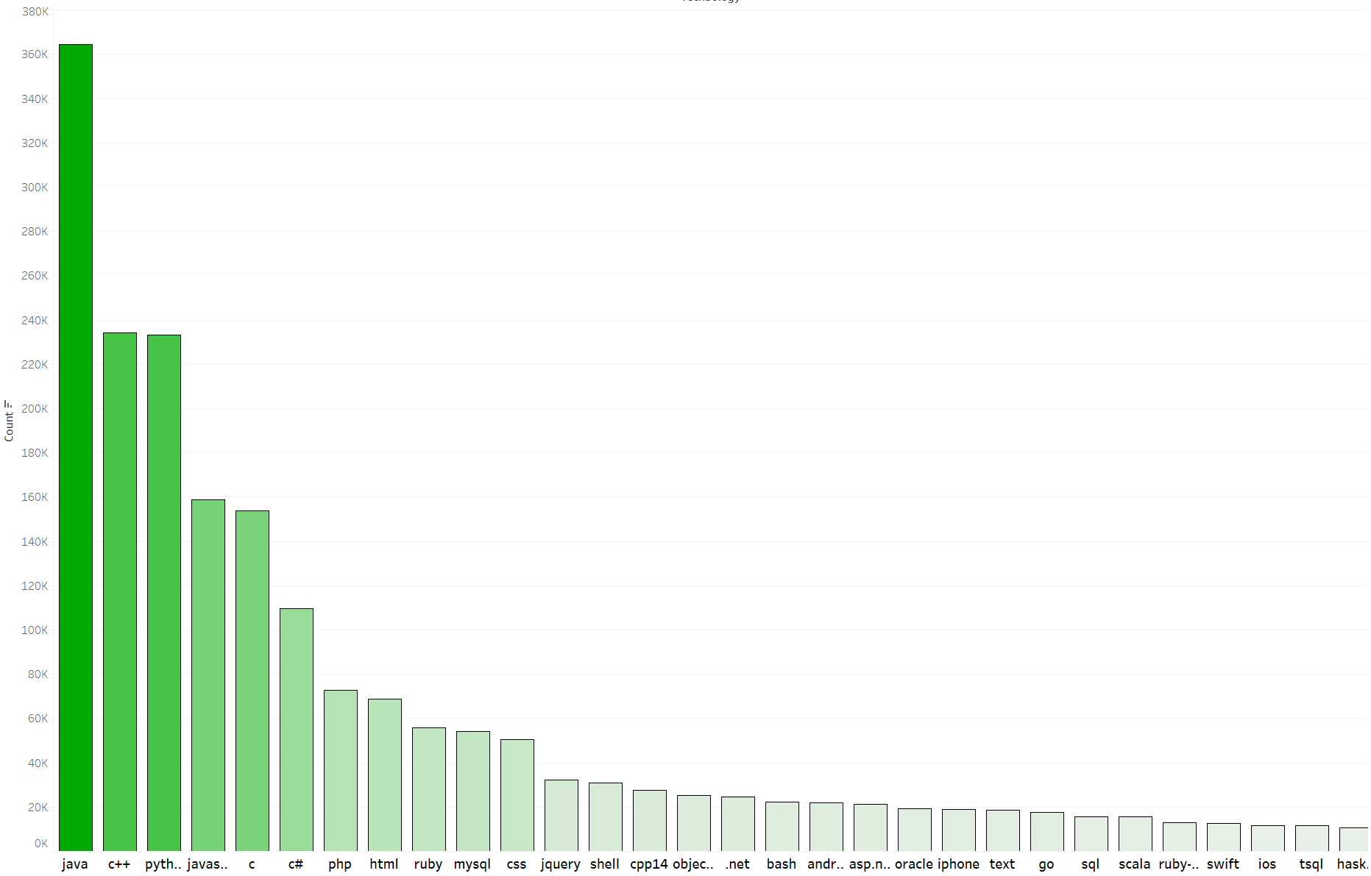
Interesting stuff contd.

Slide 16
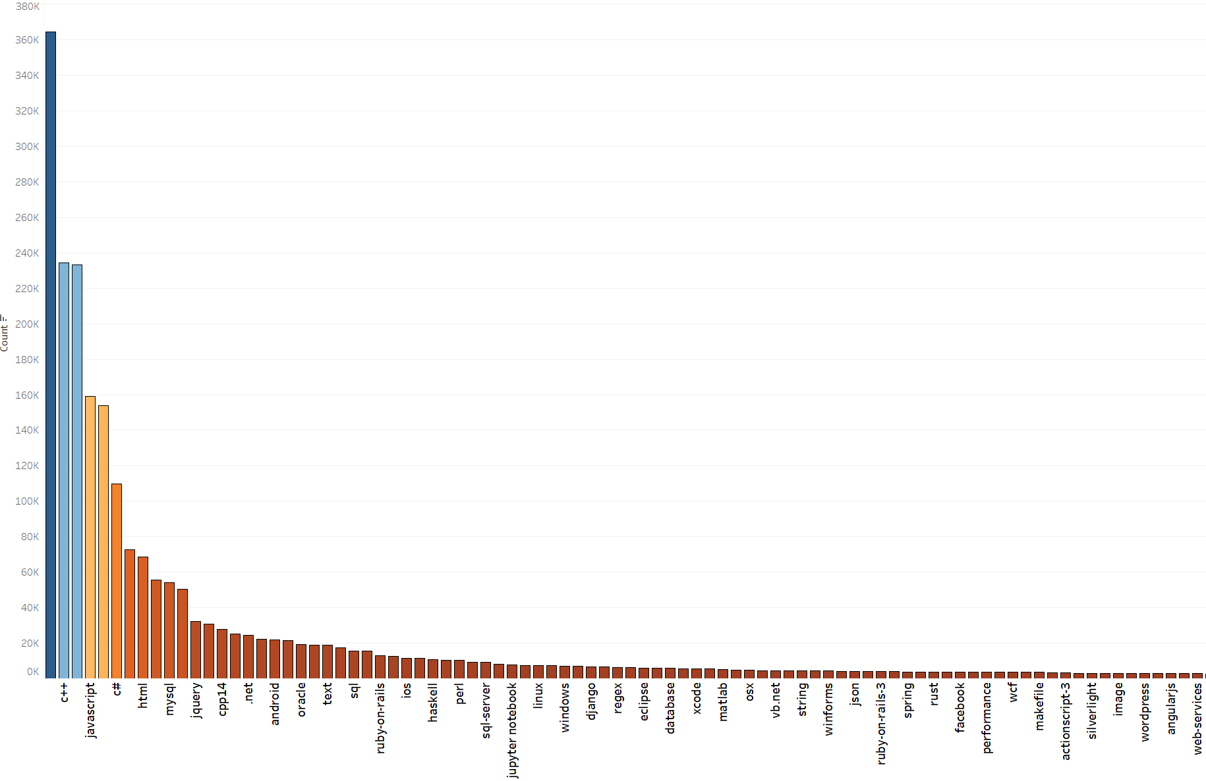
More Interesting stuff

Slide 17
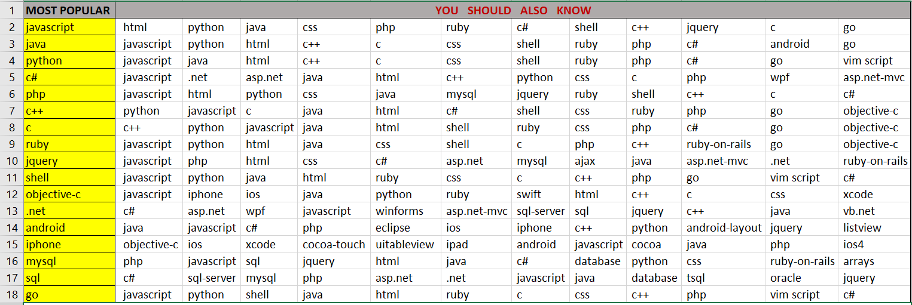
Network analysis

Slide 18
Evaluation
Sample of 100 linked entity blocks taken at random.
Each block had 3 to 7 urls, which we considered belonging to same person
Ground truth prepared by manually going through all urls, and validating.
Stats:
Precision(atleast 2 URLs match in a block) = 72/100 = 0.72
Precision(atleast 1 URL mismatch in a block) = 42/100 = 0.42
Precision(no URLs mismatch in a block) = 1-0.42 = 0.58

Slide 19
Future work
We can do better with entity linking given enough time.
Many entities do not have names and pictures. So, more sources would have reduced ambiguity.
Future version of myDig for better stability.

Slide 20
Thank You!
References
Tools and Technologies used
https://stackoverflow.com/
https://www.hackerrank.com/
https://leetcode.com/
https://github.com/
https://www.github.io/
https://www.thisispurple.com/wp-content/uploads/shutterstock_85451623.jpg
Anaconda 2.7
Scrapy
Selenium
myDig
OpenRefine
Tableau

